Slide 1
E-library of search books
NAME : GAMIDI AJAY
REG NO :192021034
SAVEETHA SCHOOL OF ENGINEERING*

Slide 2
Aim :
TO ANALYSE E-LIBRARY OF SUARCH BOOK MODEL

Slide 3
Requirements :
LOGIN FORM
BOOK ENTRY FORM
USER ACCOUNT FORM
BOOK RETURN FORM

Slide 4
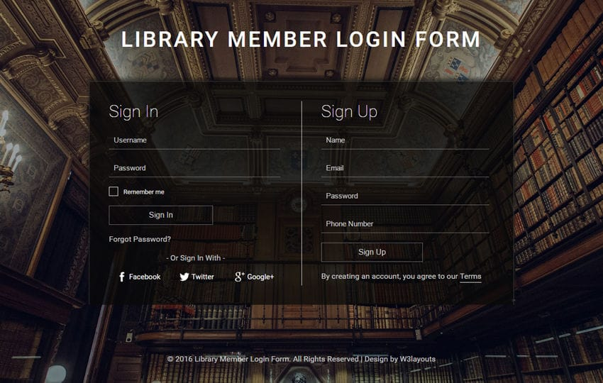
Login form

Slide 5
Test cases :
Sl.no | Test case | Excepted result | Test result
1 | Enter valid name and password & click on login button | Software should display main window | Successful
2 | Enter invalid | Software should not display main window | Successful

Slide 6
BOOK ENTRY FORM:
SL.NO | TEST CASE | EXCEPTED RESULT | TEST RESULT
1 | On the click of ADD button | At first user have to fill all fields with proper data , if any Error like entering text data instead of number or entering number instead of text. | Successful
2 | On the Click of DELETE Button | This deletes the details of book by using Accession no. | Successful

Slide 7
USER ACCOUNT FORM :
SL.NO | TEST CASE | EXCEPTED RESULT | TEST RESULT
1 | On the click of ADD button | At first user have to fill all fields with proper data , if any Error like entering text data instead of number or entering number instead of text. | Succesasful
2 | On the Click of DELETE Button | This deletes the details of student by using Register no. | Successful

Slide 8
TEST SCENARIO :
Check if the username field accepts valid username and password field accepts valid password.
Check if the wrong username and valid password allows access to any specific account.
Check if the valid username and wrong password allows access to any specific account.
Check if the forgot username link leads to username recovery page.
Check if the forgot password link leads to the password recovery page.
Check if the invalid username and password triggers any warning.
Check if the invalid credentials open the random account.
Check if the user is logged in, allows you to logout by using the link at the bottom of the application.
Check if the logout link function as expected.

Slide 9
CONCLUSION :
The collection, organization, preservation and dissemination ofinformation and knowledge are the goals of librarianship.
They are never-ending processes requiring changes in implementation as environments change.

Slide 10


